Slide 1
Chapter - 1 INTRODUCTION TO INFORMATION TECHNOLOGY STD - F.Y.J.C

Slide 2

Definition:
Information Technology is
creating, gathering, processing, storing and delivering information.

Slide 3

Creating
Gathering
Processing
Storing
Delivering Information

Slide 4
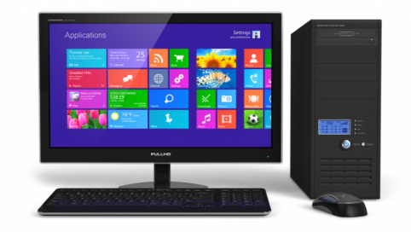
C - Commonly O - Operated M - Machine P - Particularly U - Used for T - Technology E - Education and R - Research
Computer is an electronic device
that is designed to work with Information.

Slide 5
C - Commonly O - Operated M - Machine P - Particularly U - Used for T - Technology E - Education and R - Research
C → Common
O → Oriented
M → Machine
P → Particularly
U → United and used under
T → Technical and
E → Educational
R → Research

Slide 6
C - Commonly O - Operated M - Machine P - Particularly U - Used for T - Technology E - Education and R - Research
The term COMPUTER is derived from the Latin term ‘computare’, this means to calculate or programmable machine.
Computer can not do Anything without a Program

Slide 7
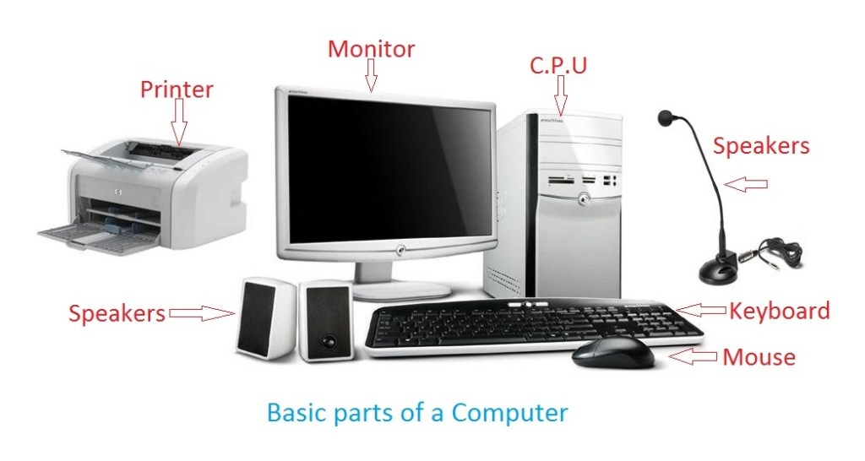
C - Commonly O - Operated M - Machine P - Particularly U - Used for T - Technology E - Education and R - Research

Slide 8
C - Commonly O - Operated M - Machine P - Particularly U - Used for T - Technology E - Education and R - Research
Parts of computer
Primary
Monitor
Secondary
Printer
C.P.U
Keyboard
Mouse
Scanner
Speakers
Headphone

Slide 9
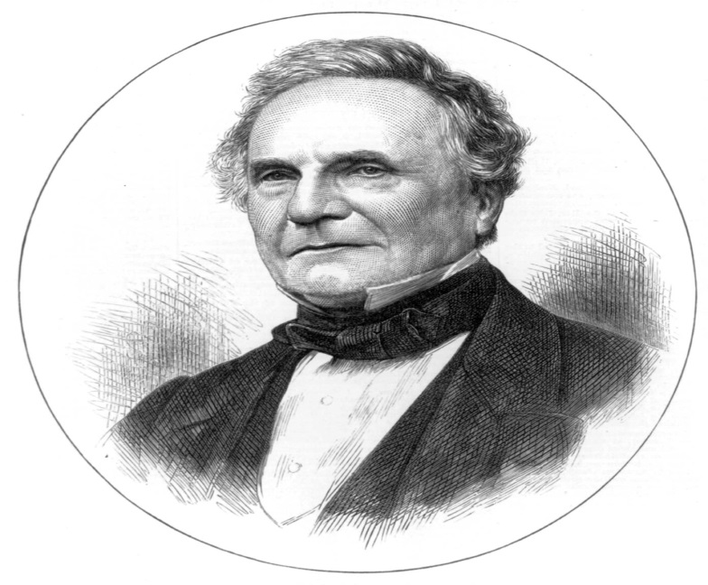
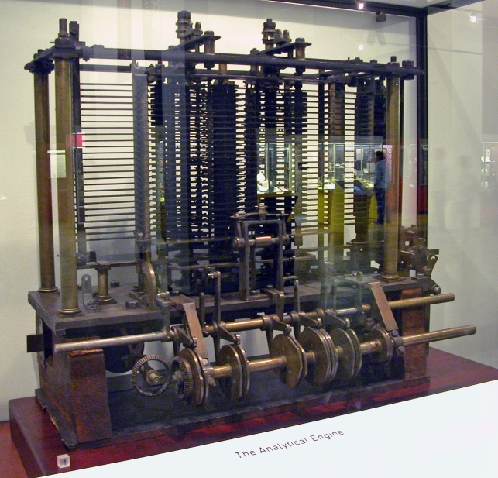
C - Commonly O - Operated M - Machine P - Particularly U - Used for T - Technology E - Education and R - Research
Charles Babbage is called the "Grand Father" of the computer.
The First mechanical computer designed by Charles Babbage was called Analytical Engine.

Slide 10
Hardware
software
Computer Consists of two main Parts .
Point1
Point 2
Point 3

Slide 11
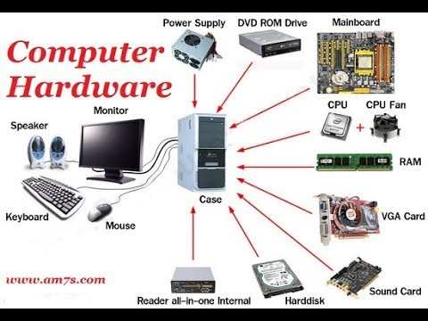
C - Commonly O - Operated M - Machine P - Particularly U - Used for T - Technology E - Education and R - Research
Computer Hardware refers to the physical parts of a computer and related devices.
AND MANY MORE……

Slide 12
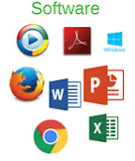
C - Commonly O - Operated M - Machine P - Particularly U - Used for T - Technology E - Education and R - Research
Software, is a collection of
DATA
or
INSTRUCTIONS
that tell the computer how to work.

Slide 13
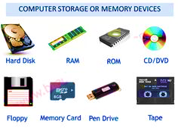
C - Commonly O - Operated M - Machine P - Particularly U - Used for T - Technology E - Education and R - Research
A computer storage device is any type of Hardware that stores data.
Computer's primary hard drive stores the operating system, applications, and files and folders for users of the computer.

Slide 14
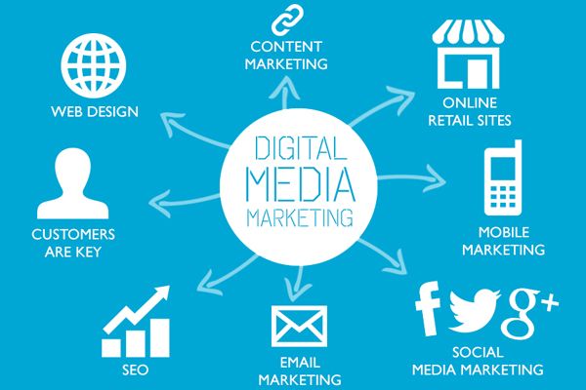
C - Commonly O - Operated M - Machine P - Particularly U - Used for T - Technology E - Education and R - Research
Computer software includes computer programs, libraries and related non-executable data, such as online documentation or digital media.

Slide 15
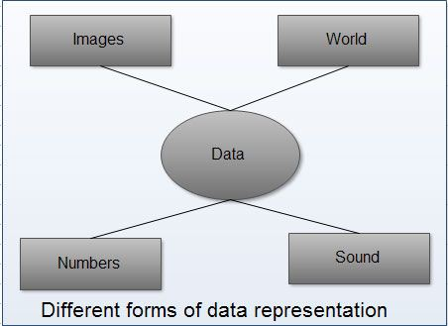
Point1
Data is defined as facts or figures, or information that's stored in or used by a computer.
Point 2
Point 3

Slide 16
Information is organized or classified data, which has some meaningful values for the receiver.
Information is the processed data on which decisions and actions are based.
Point1
Input
processing
Output
Point 2
Point 3

Slide 17
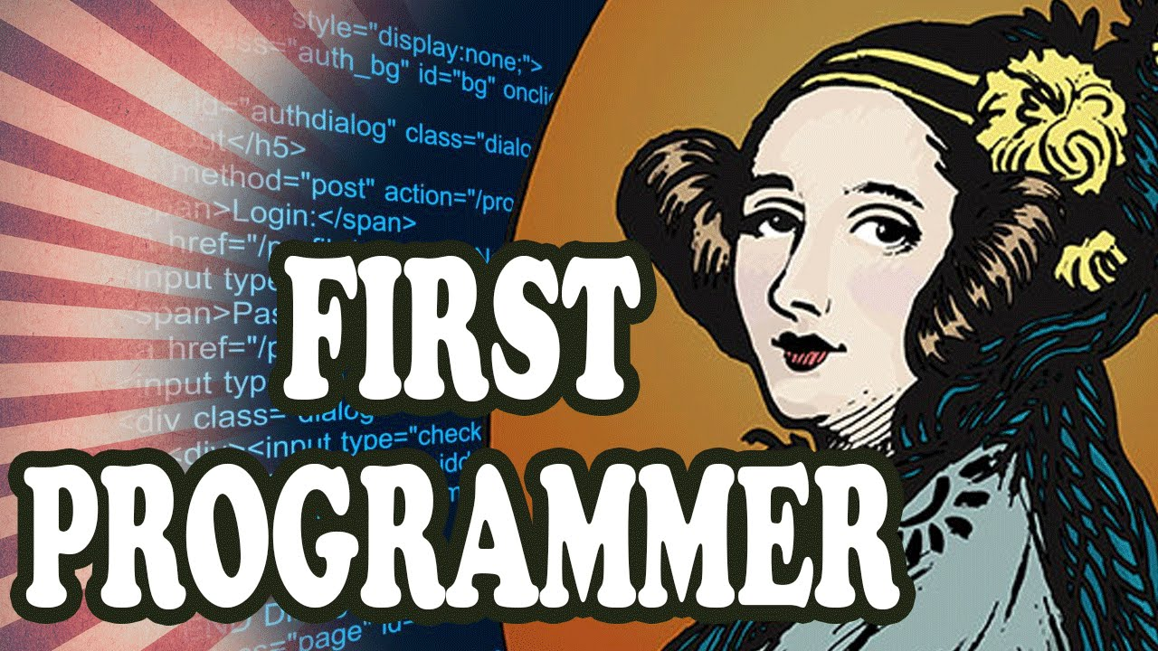
The first piece of software was written by Ada Lovelace in the 19th century, for the planned Analytical Engine.
Point1
Point 2
Point 3

Slide 18
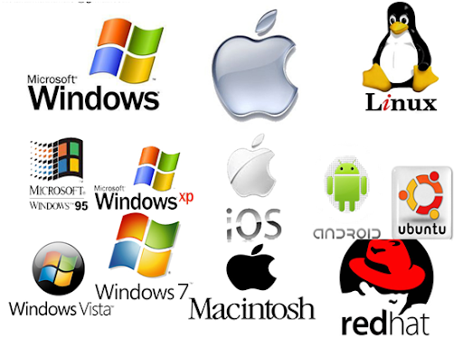
OPERATING SOFTWARE
An OPERATING SYSTEM, or SYSTEM SOFTWARE is Software that communicates with the hardware and allows other programs to run.
Every desktop computer, tablet, and smartphone includes an Operating system that provides basic functionality for the device.
Point1
Point 2
Point 3
AND MANY MORE……..

Slide 19
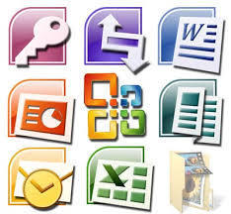
APPLICATION SOFTWARE
Application Software is a program or group of programs designed for end users.
Point1
Point 2
Point 3
AND MANY MORE……

Slide 20
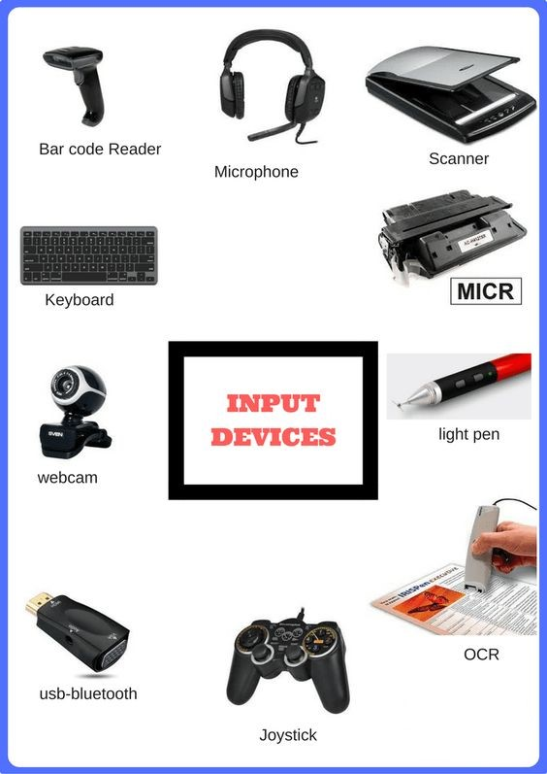
An Input device is any Hardware device that sends data to a computer, allowing you to interact with and control it.
Point1
Point 2
Point 3

Slide 21
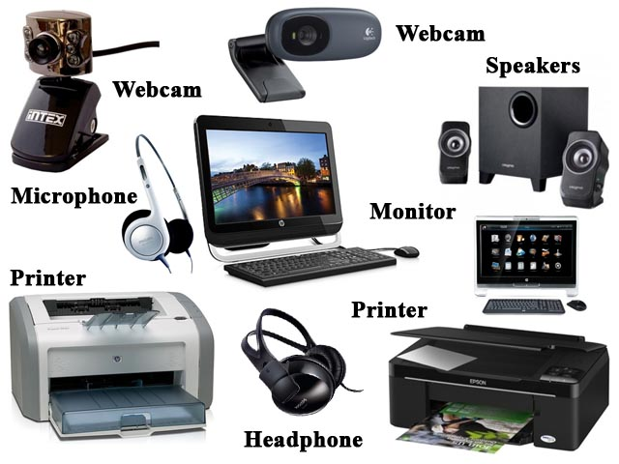
An Output device is any piece of computer hardware equipment which converts information into human-readable form.
It can be Text, Graphics, Audio, and video.
Point1
Point 2
Point 3

Slide 22
Q.1 Multiple Choice Question
____________ is Mother of computer science.
Ada lavelace B) Charles Babbage
2) Linux is ___________ software.
Application B)Operating
3) ____________ is first generation computer.
A) Super computer B) Analytical Engine

Slide 23
Q.2 State True or False
Computer is Electronic device.
Computer is Human Readable Machine.
Process means to Run.
Monitor is primary part of computer.

Slide 24
THANK YOU

